Slide 1
Project presentation
Presesnted by
Gayathri sowmya.singaraju
From 6264 batch

Slide 2
Topic : Machine Learning
CONTENTS :
1.Introduction
2.How does M.L Working?
3.Why is M.L Important?
4.Types of M.L?
5.Unsupervised Learning?
6.Two types of Unsupervised Learning?
7.Types of clustering?

Slide 3
INTRODUCTION:
Machine Learning introduced by “GEOFFREY EVEREST HINTON” Born by 6 th December 1947 is a British –Canadian cognitive psychologist and computer scientist .
FIELDS : Machine learning ,Artificial Intelligence, object recognition, neural networks.
Machine Learning is a Branch of Artificial Intelligence is the area of computational science that focuses on Analyzing and interpreting patterns and structures in data and fill the data that can be understood by human beings , reasoning and decision making outside of Human Interactions.
Example:
Whether Prediction : Predict for instance, whether or not it will Rain tomorrow.

Slide 4
How does M.L Working?
The Ultimate Goal of M.L is to design algorithms that automatically help a system gather data and use that data to learn more.

Slide 5
Why is M.L Important?
Machine Learning is important because it gives enterprises a view of trends in customer behavior and business operational patterns, as well as supports the development of new products.

Slide 6
Types of Machine Learning?
3 Types of Machine Learning:
1. Supervised Learning.
2.Unsupervised Learning.
3. Reinforcement Learning.

Slide 7
Unsupervised Learning:
In unsupervised learning only input data is provided to train model. No output data is used in unsupervised learning.
Unsupervised learning uses machine learning algorithms to analyze and cluster unlabeled datasets . These algorithms discover hidden patterns or data groupings without the need for human intervention.
Algorithms supported : supports clustering algorithms , association algorithms and neural networks.
Primary Goal : Find useful insights and hidden patterns.

Slide 8
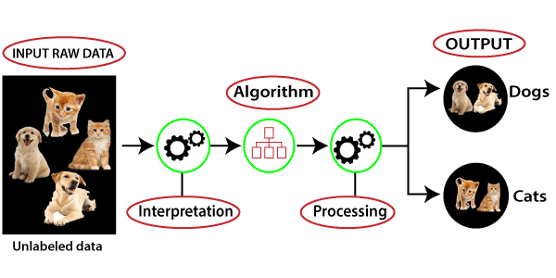
Two types of Unsupervised learning:
Clustering.
Dimensionality Reduction.
Clustering : Clustering is the process of grouping similar entities together. The goal of this Unsupervised machine learning technique is to find similarities in the data point and group similar data points together.
Example :

Slide 9
Types of Clustering:
K- Means.
Mean shift.
K- Medians.
K- Means : k-means is a technique for data clustering that may be used for unsupervised machine learning. It is capable of classifying unlabeled data into a predetermined number of clusters based on similarities (k)

Slide 10
THANK YOU

